Slide 1
Analysis of Movie Data
By Luke Monington

Slide 2
Cleaning / Preprocessing the Data
Removed duplicates
Selected columns of interest (only had time to analyze a few)
Handled Null Values - situation dependent
Dropped rows with null values in gross or budget
Filled null values with mean for title_year and duration
Filled null values with mode for aspect_ratio
Used domain knowledge to generate categorical variable for aspect_ratio column instead of numerical

Slide 3
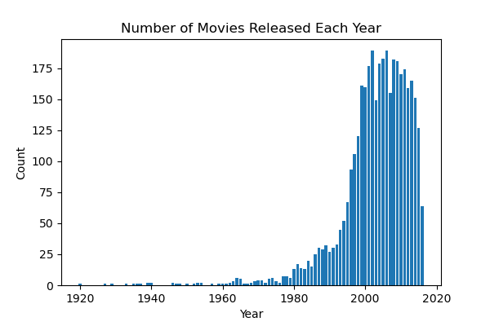
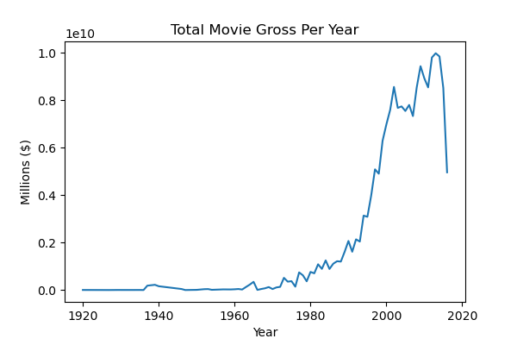
Analysis of Movies Released vs Gross per Year
The Total Gross per Year was correlated very closely with the number of movies released each year
More movies = more gross revenue

Slide 4
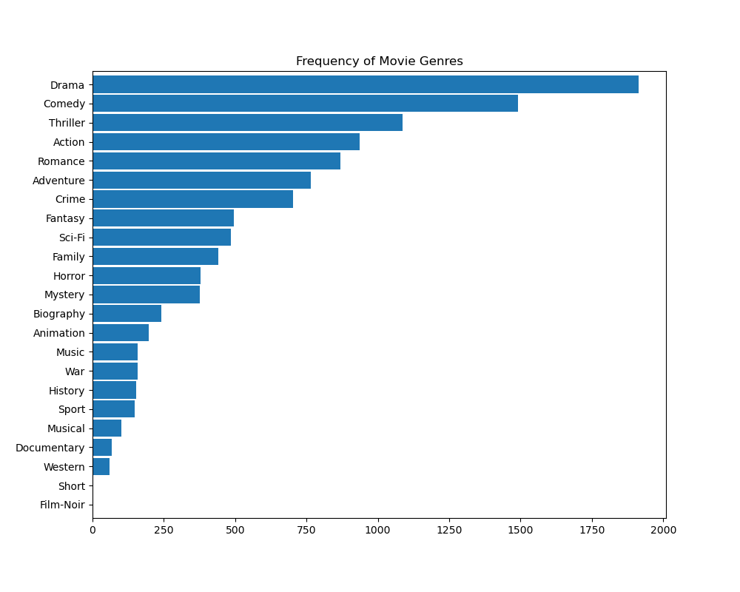
Analysis of Frequency of Movie Genres
Used statistical knowledge to determine that I will not continue to analyze the bottom 4 genres since the sample size isn’t large enough
With a 95% confidence level, population size of 100,000+ movies and a margin of error of 10%, the ideal sample should be at least 97
Notes:
First determine your Population size
Then determine your margin of error (confidence interval). How much error will you allow?
Then determine your confidence level. How confident do you want to be that the actual mean falls within your margin of error?
Next, estimate your standard deviation
Next, you need to turn your confidence level into a Z-score. Here are the Z-scores for the most common confidence levels:
90% – Z Score = 1.645
95% – Z Score = 1.96
99% – Z Score = 2.576
Sample size formula:
Necessary sample size = ((Z-score)^2 * StdDev * (1-StdDev))/(margin of error)^2

Slide 5
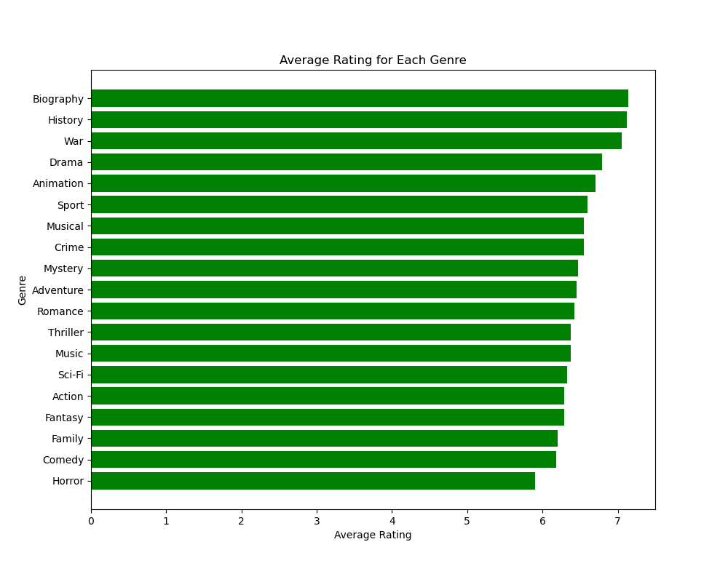
Average Rating for Each Genre
The data shows that Biography, History, and War earn the top ratings on average
Family, Comedy, and Horrow earn the lowest ratings on average

Slide 6
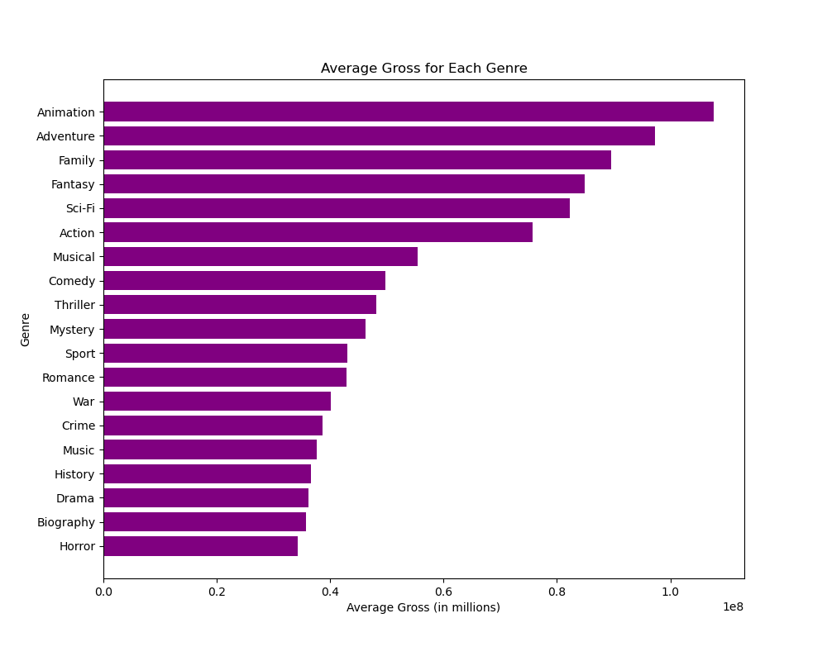
Average Gross for Each Genre
There is a lot more variance in average gross for each genre
The top genres that earn the most gross revenue are animation, adventure, and family

Slide 7
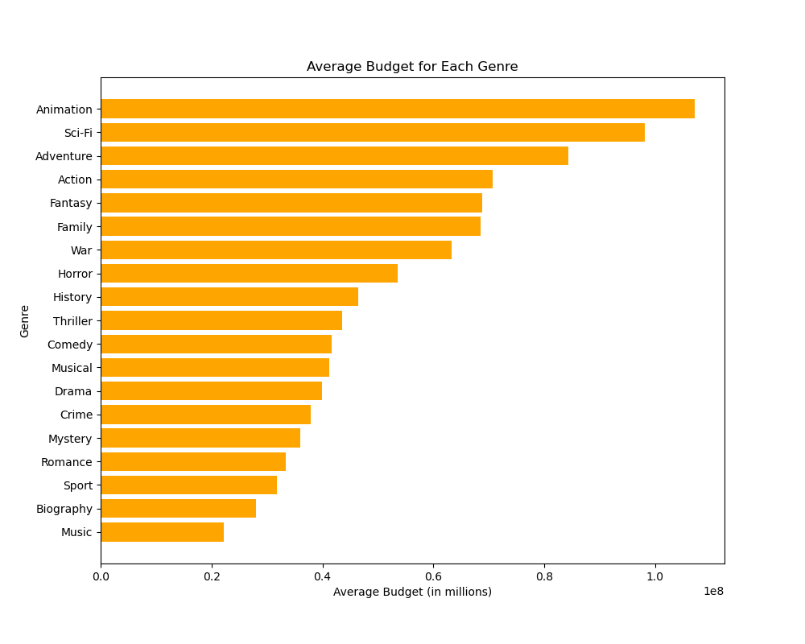
Average Budget for Each Genre
While animation has the highest gross, it also has the highest budget
Adventure has the 2nd highest gross, and it has the 3rd highest budget
The genres which command the highest budget are Animation, Sci-Fi, and Adventure

Slide 8
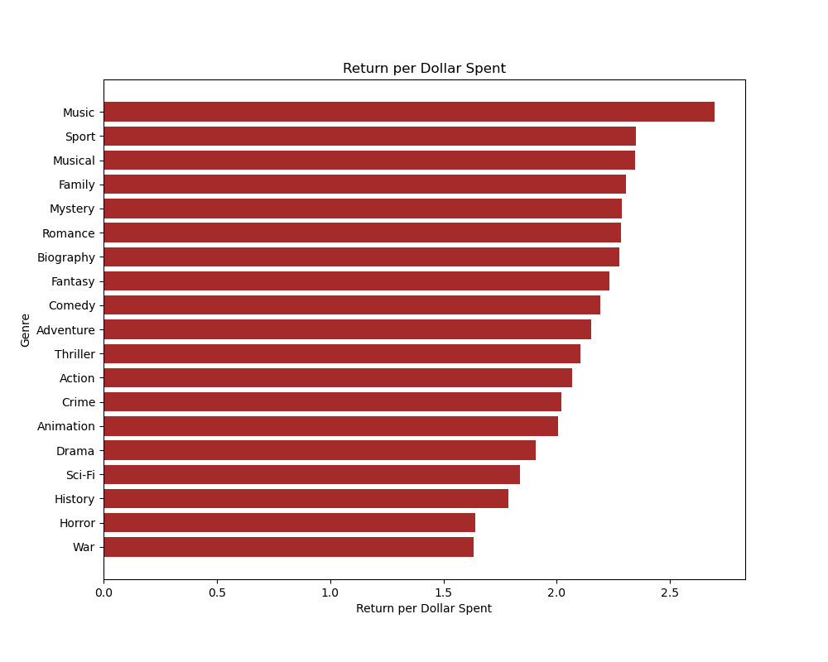
Return per Dollar Spent
Used math and domain knowledge to generate new feature
Revenue = Gross + Expenses
This chart shows revenue per dollar spent
Music earns the most return per dollar spent

Slide 9
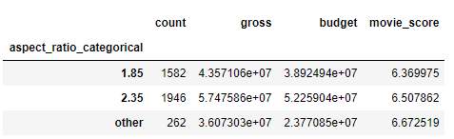
Analysis of Aspect Ratio
Movies with aspect ratios of the standard 2.35 or 1.85 typically have a larger budget and gross amount
Movies with an alternative aspect ratio have a slightly better movie score
This may be because movies with an alternative aspect ratio are more niche and artistic, so they appeal better to a target audience, although they receive less funding and attention

